Slide 1
Computer Organization & Assembly Language (CSC-205)
Lecture 15

Slide 2
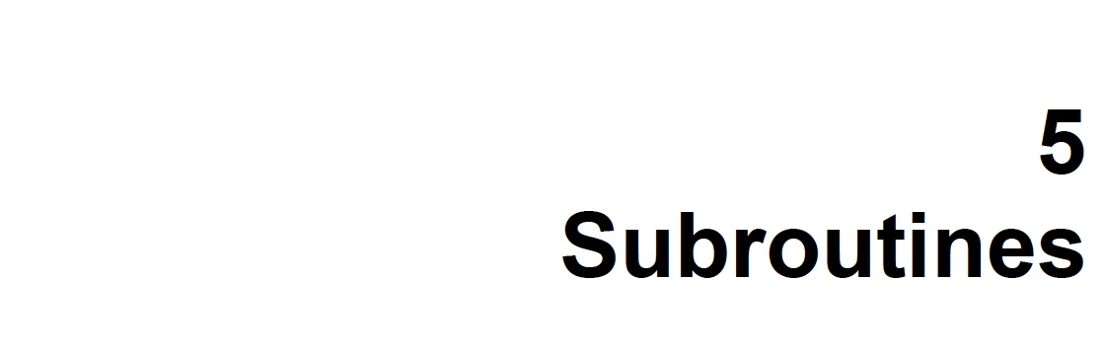

Slide 3
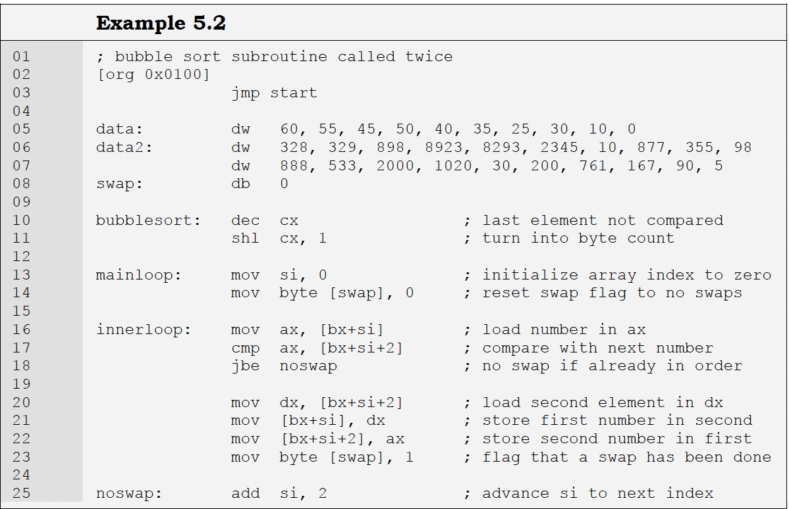

Slide 4
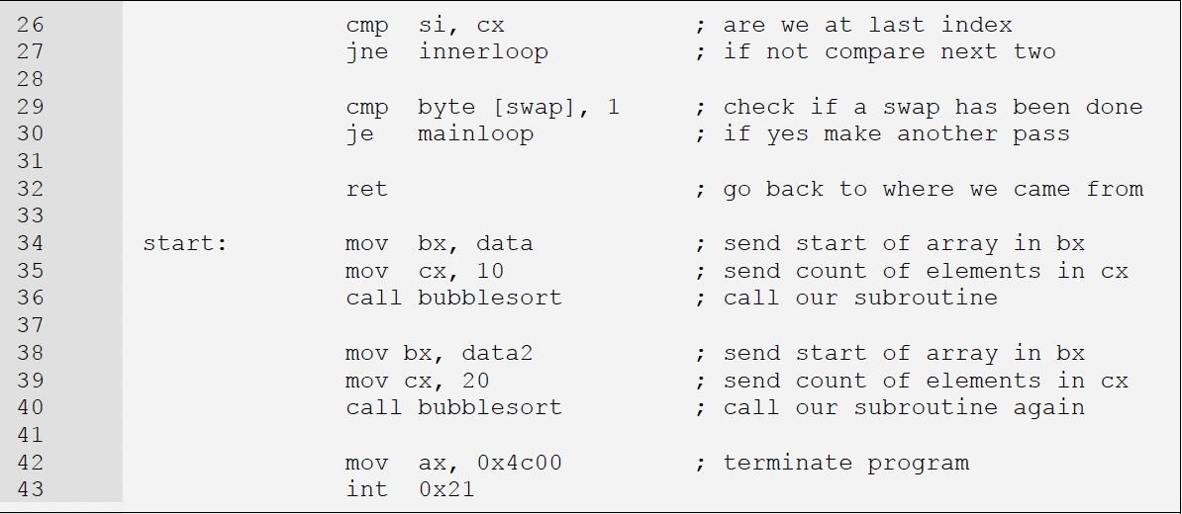

Slide 5
5.3. STACK
What is a Stack?
A Stack is a data structure following Last In, First Out (LIFO) principle
Only the top element can be accessed for addition or removal
Visual Example: Like a test tube of balls - only the top ball can be removed.
Key Stack Operations ?
Push: Add an element to the top of the stack
Pop: Remove the top element from the stack
Peek (Read): You can look at elements inside, but can only remove from the top

Slide 6
5.3. STACK
Stack Behavior in Processors ?
In 8088 processor, stack works with word-sized (2 bytes) data only
The stack uses two registers:
SP (Stack Pointer): Points to top of the stack
SS (Stack Segment): Identifies stack's memory area
Physical Address = SS:SP
Decrementing vs Incrementing Stack
8088 uses a Decrementing Stack:
Stack grows from higher to lower memory addresses
SP is decremented by 2 on push
SP is incremented by 2 on pop
Example:
Start at shelf 5 → next item in shelf 4 → then shelf 3
*Other processors (like 8051) may use incrementing stacks

Slide 7
5.3. STACK
PUSH and POP Operations (Examples)
Push Operation:
SP = SP - 2
[SP] = Operand (e.g. AX)
POP Operation:
Operand = [SP]
SP = SP + 2
Example
push ax pushes AX register onto stack
pop ax retrieves it back

Slide 8
5.3. STACK
Importance of Stack
Used to save and restore values (like register contents)
Helps in:
Subroutine calls (saving caller's registers)
Program flow control (via CALL and RET)
CALL and RET Instructions
CALL:
Saves current Instruction Pointer (IP) on stack
Loads new address in IP
RET:
Pops saved IP back to continue execution
RET n: Additionally increments SP by n after return (used in parameter passing)

Slide 9
5.3. STACK
CALL and RET - Near and Far
Near CALL/RET:
Within the same segment
Far CALL/RET (RETF):
Across segments
Pushes both Segment (CS) and Offset (IP) on stack
RETF restores both
CAUTION with PUSH and POP
The processor doesn't check logical correctness.
push ax followed by pop dx is technically valid but may be logically wrong
Ensure correct order:
The order of POP must be the reverse of PUSH

Slide 10
5.3. STACK
Stack during Nested Subroutine Calls
Stack can handle nested subroutines
Each subroutine can:
Push its own data and return address
Use stack to manage data safely during complex calls

Slide 11
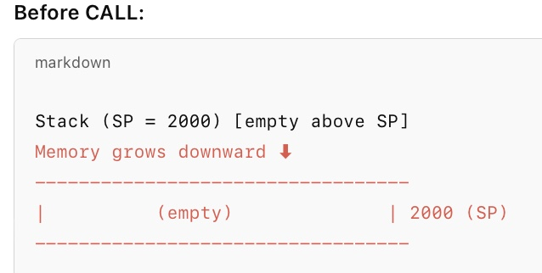
5.3. CALL and RET Example (Near CALL)
Scenario:
Main program at IP = 3000 calls subroutine at 4000

Slide 12
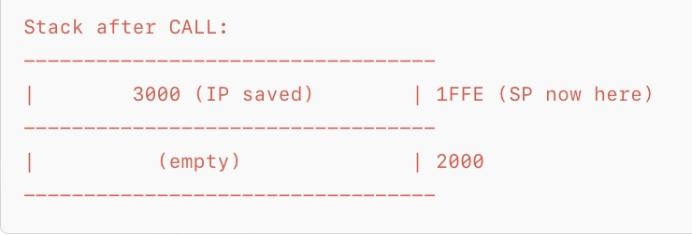
5.3. CALL and RET Example (Near CALL)
During CALL:
IP (3000) is pushed on stack
SP becomes 1FFE
IP becomes 4000

Slide 13
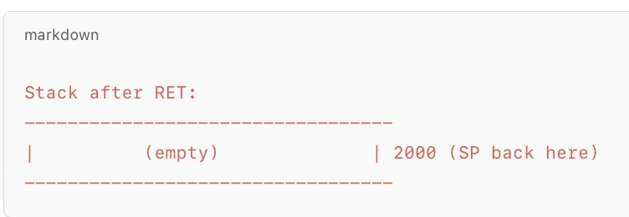
5.3. CALL and RET Example (Near CALL)
During RET:
IP is popped from stack
SP becomes 2000
IP becomes 3000 (back to main program)

Slide 14
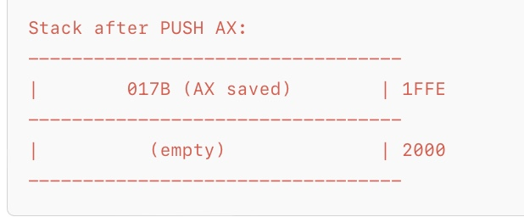
Diagram 2: PUSH and POP Example
PUSH AX (AX = 017B):
AX is pushed on stack
SP becomes 1FFE

Slide 15
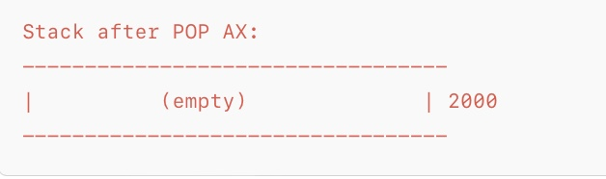
Diagram 2: PUSH and POP Example
POP AX :
AX is popped from stack
SP becomes 2000

Slide 16
Diagram 3: Nested CALL Example
Main Program → CALL Subroutine1 → Subroutine1 calls Subroutine2
CALL Subroutine1:
Push IP1 (Main address)
SP = 1FFE
In Subroutine1 → CALL Subroutine2:
Push IP2 (Subroutine1 address)
SP = 1FFC
Make the diagram ?
Also tell me :
Output of RET from Subroutine2 ?
Output of RET from Subroutine1 ?

Slide 17
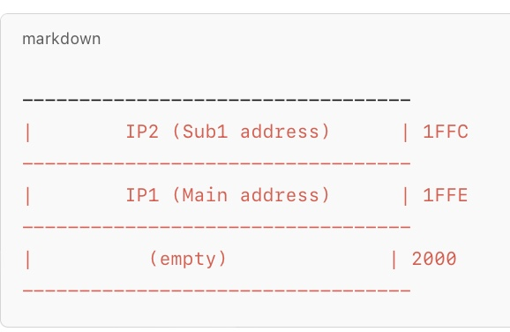
Diagram 3: Nested Call Example

Slide 18
Diagram 3: Nested CALL Example
RET from Subroutine2:
IP2 is popped
SP becomes 1FFE
RET from Subroutine2:
IP1 is popped
SP becomes 2000

Slide 19
End of Lecture

